Slide 1
Hand Gesture Recognition System using Convolutional NeuraL Networks
SRI MANI PRUDHVI PEDDI LONG ZHUANG LI
Department of Computing Sciences
Texas A&M University-Corpus Christi
Corpus Christi, TX 78412

Slide 2
OVERVIEW
INTRODUCTION
RELATED WORKS
PROPOSED FRAMEWORKS
DATASETS
DIFFERENCES
REFERENCES

Slide 3
INTRODUCTION
Gesture is an important means of communication and gesture recognition technology has opened up a new situation of human interaction with machines, devices or computers.
Gesture Recognition techniques is mainly used in
Image Processing
Pattern Recognition
Sign Language Recognition
Robotics

Slide 4
INTRODUCTION (CONT..)
The objective of these methods is to bridge the communication gap between speech and hearing-impaired people with the normal people and successful and smooth integration of these differently abled people in our society
In order to facilitate communication between deaf and hearing people, sign language interpreters are often used. Such activities involve considerable effort on the part of the interpreter, since sign languages are distinct natural languages with their own syntax, different from any spoken language .

Slide 5
Related Works
(M. Al-Hammadi et al., 2020) evaluated a novel system for dynamic hand gesture recognition through a collection of multi-modality deep learning techniques. Algorithm used: 3D Convolution Neural Network.
G. Yuan et al., 2021) developed a hardware based system to recognize the gesture. Algorithm used: Deep feature fusion and LSTM model.
(N. Siddiqui et al., 2021) evaluated a system using acoustic data measured at the wrist. Based on 36 gestures as per American Sign Language. Algorithm: SVM, LDA

Slide 6
Proposed works
The proposed system consists of modules that capture the real time data using the web camera. The captured image is further preprocessed to make the constant image size, converting the image into gray scale image and binary image etc
The binary image is further background subtracted using the reference image through Gradient mixture modeling (GMM )
We propose a computer vision based approach to recognize static hand gestures. The system would analyze a video feed and recognize the hand gesture and then output the correct class label

Slide 7
existing Vs proposed methodology
Existing Methodology:
In existing, they tackled background problems, variation in lighting condition problems.
And edge detection based hand gesture recognition has the issues such as false edge detection, broken edges, high computation time and less recognition accuracy.
Proposed Methodology:
To solve the background and lighting problems.
Use effective method for reduce the computation time and increase the recognition accuracy

Slide 8

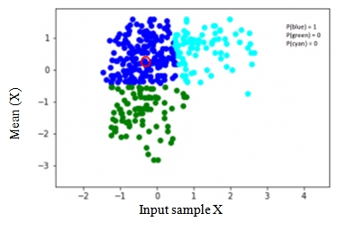
PROPOSED WORKS - Concept
Gaussian Mixture modeling (GMM)
Gaussian mixture model (GMM) is a kind of clustering algorithm. Each clustered semantic object is generated with unique Gaussian distribution.

Slide 9
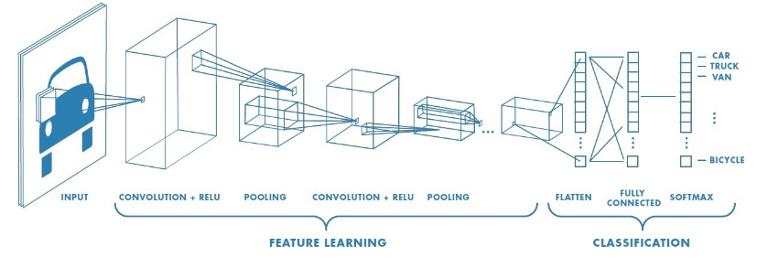
PROPOSED WORKS (CONT..)
Multi-layer Convolution Neural Network (MLCNN)
Convolution neural networks are a deep learning algorithm which considers the input image and learn the unique information from the image through weight or bias assignment in terms of various aspects. The weight assignment is based on image pattern, shape and size to show the differentiation. The architecture of MLCNN is shown above.

Slide 10
Image recognition
The last phase in the system is the image recognition phase. In order to achieve higher accuracy as compared to existing systems and to keep the system computationally lightweight, we make use of Convolutional neural network (CNN) for image recognition. Convolutional neural network are a class of feed-forward artiﬁcial neural networks commonly used for visual analysis tasks. They comprise of neurons which act as learnable parameters having their own weight and biases. The entire neural network learns with the help of a loss function, a learning rate is used to ﬁne tune the learning
. The input layer takes in the data which gets propagated through the various layers and a output is generated, the generated output is com- pared with the actual output and the system updates its weights and biases to correct itself, this step is crucial and is known as backpropagation and this process done iteratively is called as training. The training duration of CNN is decided according to the size, the number of layers and also the learning rate. The CNN was trained using the ASL sign language image dataset consisting of around 35K images with each class having a minimum of 800 images.

Slide 11
Performance of parameters for existing and proposed methodologies
Parameters Value | Existing CNN | Proposed RESNET
Hidden Layer | 7 | 7
Dropout layer | 1 | 0
Number of filters per Convolutional Layer | 3264 | 3264
Batch size | 32 | 64
Activation Function | reLu | reLu
Optimizer | Adam | xception
Epochs | 30 | 50
Kernel Size | (3, 3) | (5x5)
Size of Pool | (2, 2) | (3x3)
Strides | (2, 2) | (2x)

Slide 12
Performance of Existing methods and proposed method in terms of accuracy
Dataset | Real time images | Real time images
Algorithm | Multi-layer CNN | CNN-Residual Network
Optimizer | Adam | xception
Epochs | 30 | 50
Accuracy | 99.13 | 99.25

Slide 13
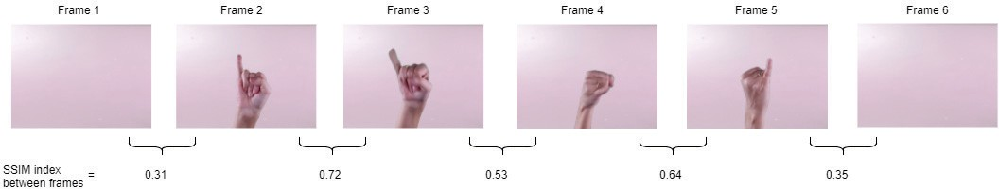
DATASETS
Gesture images are dynamic in nature. The hand gesture data varies with changes in external lighting, intensity etc. the dynamic changes enable the object gesture vary with different scales. For the proposed work, Real time live images are captured using web camera. The unique gesture points and the landmarks of the gesture, shape and size etc. The image acquisition is collected with even light intensity and gathered as the dataset. For training purpose same gesture is captured N number of times as samples. Each gesture is formulated with the labels as well.

Slide 14
EXAMPLES IN DATASETS
BACK-
CLOSE-
ENTER-
MAXIMIZE-
MINIMIZE-
NEXT-

Slide 15
EXAMPLES OF DATASETS (CONT..)
PREVIOUS-
SPACEBAR-
VOLUME DOWN-
VOLUME UP-

Slide 16
DIFFERENCES OF EXISTING AND PROPOSED WORK
In the existing system, MLCNN architecture with primitive feature extraction process is done. The feature extraction part in the existing system extract the alignment angle of the input image as texture. These parameters are fetched into the proposed CNN for classification. The drawback found in the existing architecture is computationally complex and overfitting is the issue.
In the proposed model keeping these points in mind a residual network with CNN architecture is framed. The proposed architecture is nothing but a customized network that adopt the layer performance through tunable factors such as weight adjustment, loop adjustment classifies the input image with less complexity and less processing time. The over fitting issue is not found with the proposed one due to the tunable factors available.

Slide 17
Conclusion
Gesture detection becomes one of the interesting area of research since many AI-Artificial intelligence models depends on the gesture inputs. Effective recognition of hand gesture is the goal of computer vision to interpret and manage the classification with high accuracy. The proposed system is evaluated with such criteria, using Gaussian mixture model (GMM) based Convolution neural networks (CNN). The ensemble version of GMM-CNN enables the system to interpret the hand gestures effectively. The system considers both static and dynamic input modeling and hence the performance achieved is comparatively effective. The proposed GMM-CNN enhanced gesture detection system achieved 99.25% accuracy with real-time images using exception model and 99.13% accuracy with Multi-layer CNN Adam optimizer.

Slide 18
FUTUREWORKS
Macpi board can be used it has 3 GB inbuilt ram and an inbuilt GPU, hence the speed will improve. Real images can be captured easily. The new method should involve both hands. Deep learning method can be used for greater accuracy but deep learning cannot be implemented in raspberry pi.

Slide 19
REFERENCES
M. Al-Hammadi et al., "Deep Learning-Based Approach for Sign Language Gesture Recognition With Efficient Hand Gesture Representation," in IEEE Access, vol. 8, pp. 192527-192542, 2020, doi: 10.1109/ACCESS.2020.3032140.
S. Tam, M. Boukadoum, A. Campeau-Lecours and B. Gosselin, "A Fully Embedded Adaptive Real-Time Hand Gesture Classifier Leveraging HD-sEMG and Deep Learning," in IEEE Transactions on Biomedical Circuits and Systems, vol. 14, no. 2, pp. 232- 243, April 2020, doi: 10.1109/TBCAS.2019.2955641.
G. Yuan, X. Liu, Q. Yan, S. Qiao, Z. Wang and L. Yuan, "Hand Gesture Recognition Using Deep Feature Fusion Network Based on Wearable Sensors," in IEEE Sensors Journal, vol. 21, no. 1, pp. 539-547, 1 Jan.1, 2021, doi: 10.1109/JSEN.2020.3014276.
C. Liu, Y. Yang, X. Liu, L. Fang and W. Kang, "Dynamic- Hand-Gesture Authentication Dataset and Benchmark," in IEEE Transactions on Information Forensics and Security, vol. 16, pp. 1550-1562, 2021, doi: 10.1109/TIFS.2020.3036218.

Slide 20
REFERENCES (CONT..)
N. Siddiqui and R. H. M. Chan, "Hand Gesture Recognition Using Multiple Acoustic Measurements at Wrist," in IEEE Transactions on Human-Machine Systems, vol. 51, no. 1, pp. 56-62, Feb. 2021, doi: 10.1109/THMS.2020.3041201.
S. Shin and W. Kim, "Skeleton-Based Dynamic Hand Gesture Recognition Using a Part-Based GRU-RNN for Gesture-Based Interface," in IEEE Access, vol. 8, pp. 50236-50243, 2020, doi: 10.1109/ACCESS.2020.2980128.
W. Zhang, J. Wang and F. Lan, "Dynamic hand gesture recognition based on short-term sampling neural networks," in IEEE/CAA Journal of Automatica Sinica, vol. 8, no. 1, pp. 110-120, January 2021, doi: 10.1109/JAS.2020.1003465.
S. Jiang, L. Li, H. Xu, J. Xu, G. Gu and P. B. Shull, "Stretchable e-Skin Patch for Gesture Recognition on the Back of the Hand," in IEEE Transactions on Industrial Electronics, vol. 67, no. 1, pp. 647-657, Jan. 2020, doi: 10.1109/TIE.2019.2914621.
S. Skaria, A. Al-Hourani and R. J. Evans, "Deep-Learning Methods for Hand-Gesture Recognition Using Ultra-Wideband Radar," in IEEE Access, vol. 8, pp. 203580-203590, 2020, doi: 10.1109/ACCESS.2020.3037062.

Slide 21
THANKYOU

